Slide 1

Course Name : Agile Software Development (CSEN2111)51 )
Dr.T.SRINIVASA RAO
Associate Professor
Department of CSE
GITAM School of Technology (GST)
Visakhapatnam – 530045
Email: sthamada@gitam.edu

Slide 2
SYLLABUS
Agile software development practices enable customer centric software development with collaborative teamwork centred around people. This course elaborates agile development principles and techniques covering the entire software development process from problem conception through development, testing and deployment to equip the learner with practical software development methodology.

Slide 3
Course objectives:
1. To understand the agile concept and its importance in software development.
2. To acquire complete knowledge on Extreme programming.
3. To know complete modelling of agile processes on the XP environment.
4. To acquire knowledge on Scrum.
5. To familiar with Feature driven development

Slide 4
UNIT-1
Module I: Introduction Number of hours (LTP) 6 0 4
Introduction: The Agile manifesto, Agile methods, XP: Extreme Programming, DSDM, SCRUM,
feature- Driven Development, Test Driven Development, modelling misconceptions, agile modelling, tools of misconceptions, updating agile models.
Learning Outcomes:
After completion of this unit, the student will be able to:
1. Understand Agile concepts (L1)
2. Distinguish different agile methods for software development(L2)
3. Describe the origins and motivations of the Agile Manifesto(L3)
4. Analyze requirements to prepare features and user stories (L4)
5. Construct different agile models(L6)

Slide 5
UNIT-2
Module II: Extreme Programming Number of hours (LTP) 6 0 4
Extreme Programming: Introduction, core XP values, the twelve XP practices, about extreme
programming, planning XP projects, test first coding, making pair programming work.
Learning Outcomes:
After completion of this unit, the student will be able to:
1. Define core XP values(L1)
2. Explain the twelve XP practices(L2)
3. Identify different XP projects(L4)
4. Justify extreme programming(L5)
5. Construct test first coding and pair programming(L6)

Slide 6
UNIT-3
Module III: Agile Modelling and XP Number of hours (LTP) 6 0 4
Agile Modelling and XP: Introduction, the fit, common practices, modelling specific practices, XP
Objections to agile modelling, agile modelling and planning XP projects, XP implementation phase.
Learning Outcomes:
After completion of this unit, the student will be able to:
1. How Agile Modelling enables developers to develop customized software(L1)
2. Illustrate common practices and specific practices(L3)
3. Apply XP objections to agile modelling(L4)
4. Distinguish agile modelling and planning XP projects(L5)
5. Create XP implementation phase(L6)

Slide 7
UNIT-4
Module IV: Scrum Number of hours (LTP) 6 0 4 Scrum: Scrum Framework, Agile Principles, Sprints, Requirements and User Stories, Product backlogs, Estimation and Velocity, Roles, Planning, Multi-level Planning, Release Planning, Sprint planning.
Learning Outcomes:
After completion of this unit, the student will be able to:
1. Understand Scrum enables developers to develop customized software(L1)
2. Demonstrate Scrum practices (L3)
3. Develop user stories (L4)
4. Develop scrum process for implementation of case study (L4)
5. Identify tools for Agile Development (L3)

Slide 8
UNIT-5
Module V: Feature-Driven Development: Number of hours (LTP) 8 0 2 Feature-Driven Development: Introduction, incremental software development, Regaining Control, motivation behind FDD, planning an iterative project, architecture centric, FDD and XP.
Test Driven Development: Unit Tests, Integration Tests, End-to-End Tests, Customer Tests.
Release Management: Version Control, Continuous Integration.
Learning Outcomes:
After completion of this unit, the student will be able to:
1. Define Feature-Driven Development(L1)
2. Demonstrate incremental software development(L2)
3. Apply regaining control techniques(L3)
4. Develop application using TDD (L4)
5. Understand Versions, Version control and Integration of Application. (L1)

Slide 9

Software Engineering: Software life cycle
Software Engineering, according to IEEE, is applying the principles of engineering to software development. In other words it applies well-defined principles and methods of engineering to develop a high quality software.
A Software engineer is a person whose main responsibility is applying Software engineering principles to analyze, design, develop and maintain the software (Software life cycle).

Slide 10
Software Development Life Cycle
SDLC stands for Software Development Life Cycle or System Development Life Cycle.
SDLC helps to develop the application in a planned and systematic fashion. There are many models available like Waterfall Model, V Model, Spiral Model etc. are used to develop the application.
SDLC is also similar kind of technique to develop the application in systematic way by following few steps.
In SDLC, software development followed by completing each phase and move to the next phase.
There are two types of SDLC approach – One is Waterfall and another is Agile.
Agile SDLC is quite new and more popular now a days, however Waterfall SDLC is traditional method of software development strategy.

Slide 11
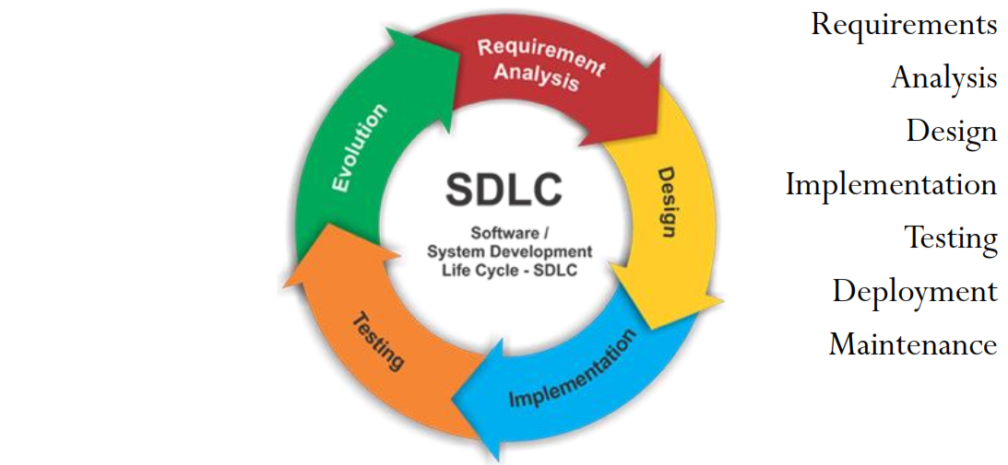
Phases in Software Development Life Cycle(SDLC) Models

Slide 12
The most common SDLC methodologies.
Evolutionary Prototyping Model.
Waterfall Model.
Extreme programming (Agile development)
Incremental Model
V-Shaped Model
Iterative Model
Spiral Method (SDM)

Slide 13
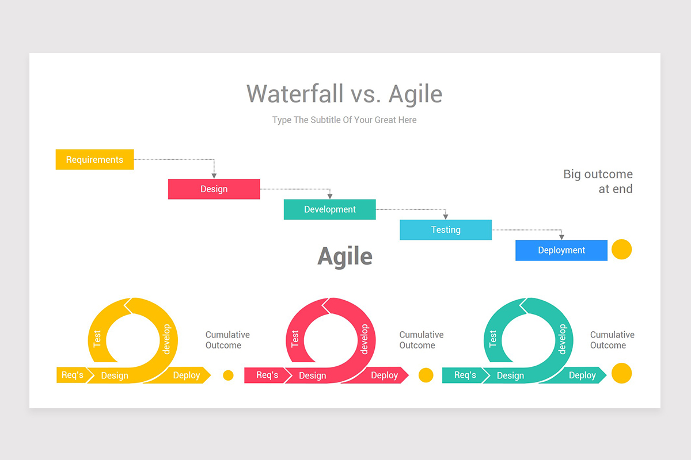

Slide 14
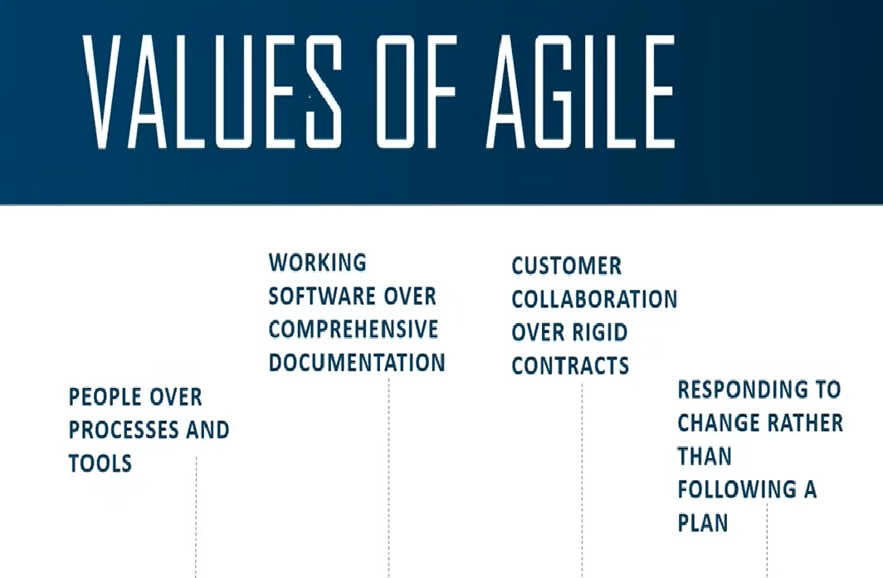

Slide 15
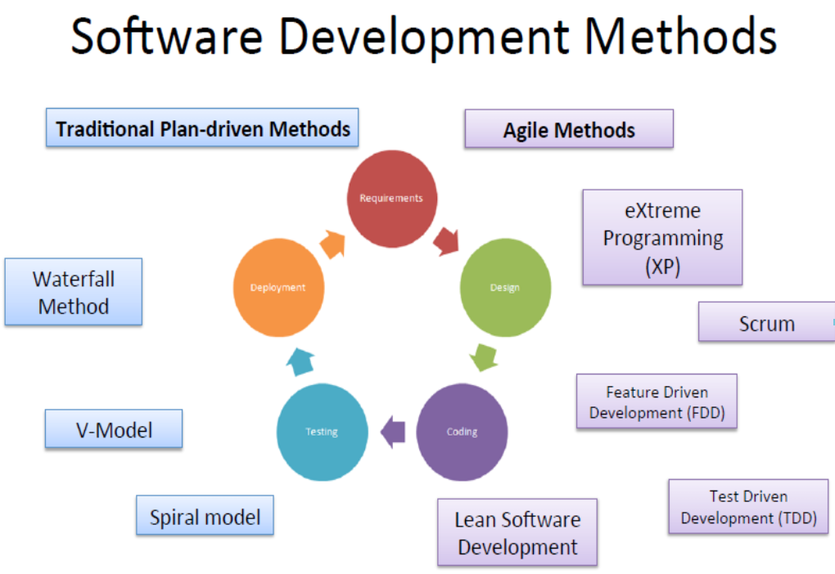
Even if we use different software development methods, we deal with the same phase requirements, design, coding, testing, and deployment- but they may have different priorities. They may be done in different manners and orders, etc.

Slide 16
Rapid software development
Rapid development and delivery is now often the most important requirement for software systems
Businesses operate in a fast –changing requirement and it is practically impossible to produce a set of stable software requirements
Software has to evolve quickly to reflect changing business needs.
Rapid software development
Specification, design and implementation are inter-leaved
System is developed as a series of versions with stakeholders involved in version evaluation
User interfaces are often developed using an IDE and graphical toolset.

Slide 17
Module I Introduction
Introduction:
The Agile manifesto
Agile methods
XP: Extreme Programming
DSDM
SCRUM
feature- Driven Development
Test Driven Development
modelling misconceptions
agile modelling
tools of misconceptions
updating agile models.

Slide 18
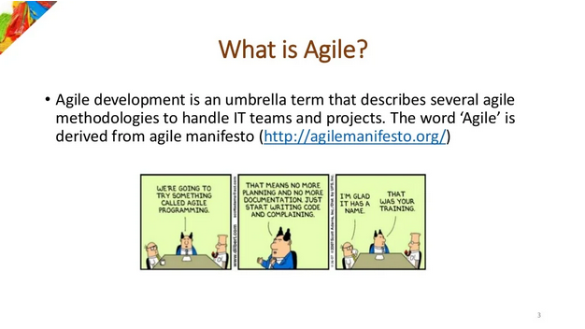

Slide 19
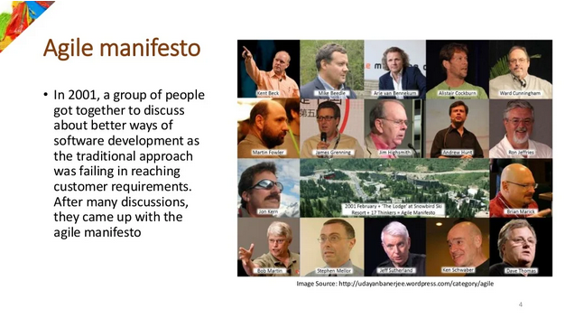

Slide 20
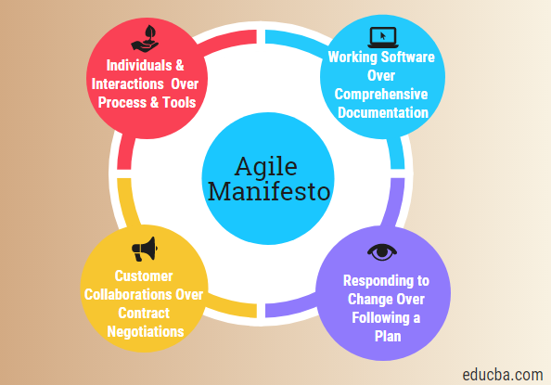

Slide 21
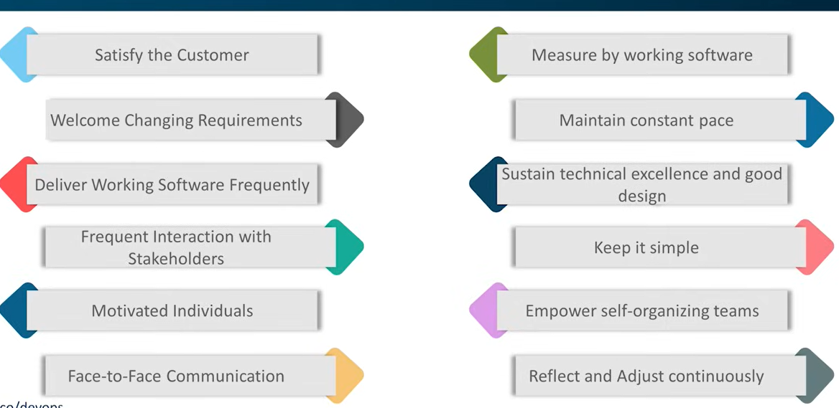
Principles of Agile

Slide 22
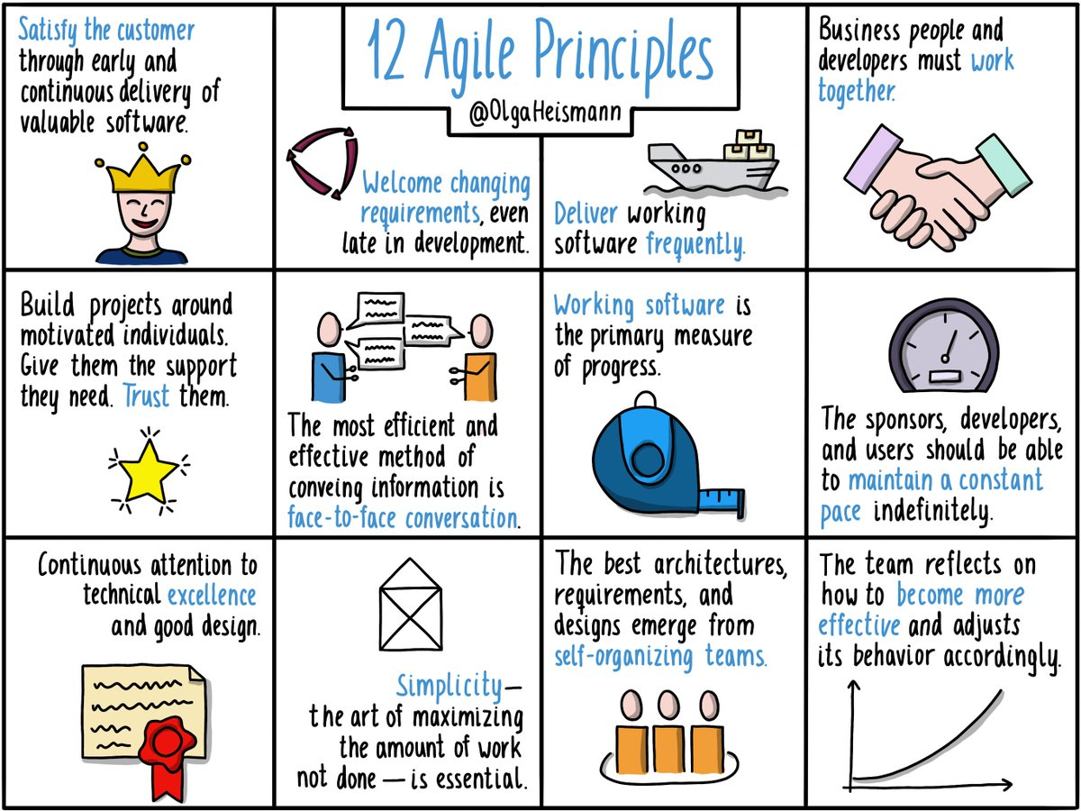

Slide 23
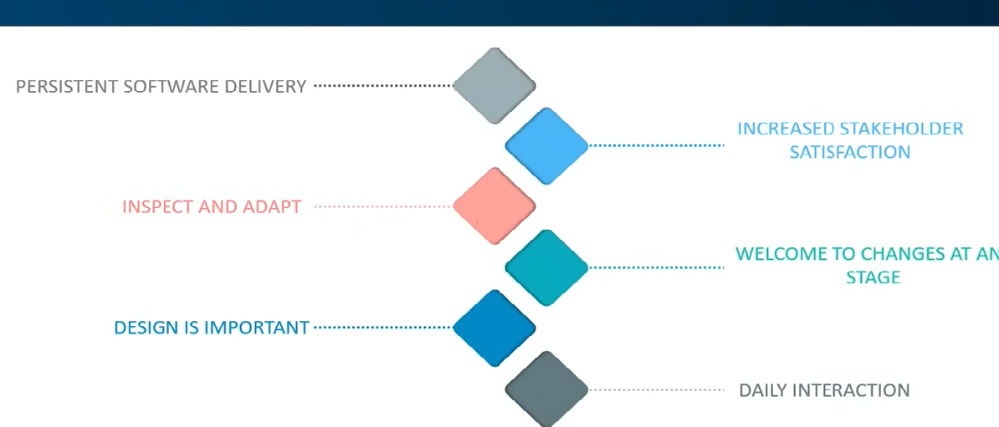
Advantages of Agile

Slide 24
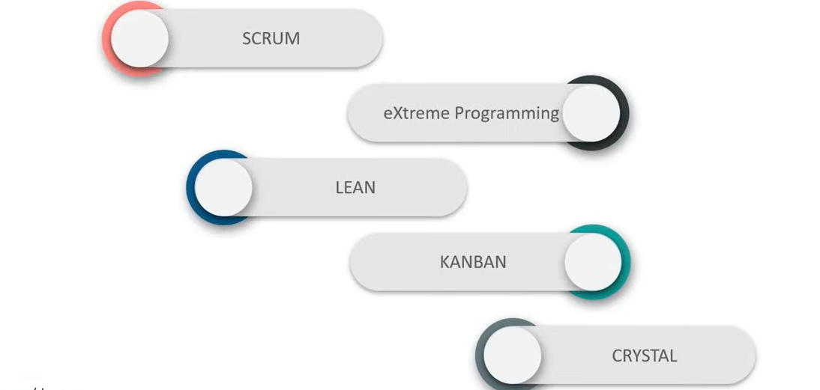
How to implement Agile

Slide 25
Agile methods
Dissatisfaction with the overheads involved in software design methods of the 1980s and 1990s led to the creation of agile methods
These methods:
Focus on the code rather than the design
Are based on an iterative approach to software development
Are intended to deliver working software quickly and evolve this quickly to meet changing requirements.
The aim of agile methods is to reduce overheads in the software process (e.g. by limiting documentation) and to be able to respond quickly to changing requirements without excessive rework.

Slide 26
The Manifesto for Agile Software Development
We are uncovering better ways of developing software by doing it and helping others do it. Through this work we have come to value:
Individuals and interactions over processes and tools
Working software over comprehensive documentation
Customer collaboration over contract negotiation
Responding to change over following a plan
That is, while there is value in the items on the right, we value the items on the left more.
Let’s look at these values to discern exactly what is meant.

Slide 27
Value 1: Individuals and Interactions over Processes and Tools
This refers to the fact that it is the people involved and how they communicate that typically has the largest bearing on the success (or failure) of a software project.
Yes, software development processes, methodologies, tools, etc., can help but they are still not the overriding influence. Thus, you should encourage the best people and group interactions.

Slide 28
Value 2: Working Software over Comprehensive Documentation
There are times when (and I am sure I am not alone in this) you can feel that all you seem to be doing is producing reams and reams of documentation.
Sometimes, this is aided (even determined) by the CASE tool you might be using and sometimes it is merely the process being followed.
However, at the end of the day it is the software produced by a development project that will be used by a user and not the documentation. Therefore, documentation should not be a major goal in and of itself. Instead, it should be a supporting medium for the actual product – the software.

Slide 29
Value 3: Customer Collaboration over Contract Negotiation
Remember these are values – thus, time should be spent on working with customers and in getting them involved in the software development rather than on detailed contract negotiations.
However, of course in the real world this can be difficult, as although your direct clients may buy into this philosophy, their legal and financial departments may not.
For example: we have worked with a number of clients where the legal (and/or financial) departments have imposed a contract and associated negotiations because they want something to hit us with, if things go wrong.

Slide 30
Value 4: Responding to Change over Following a Plan
Finally, agile software development embraces change rather than saying “it’s not in the requirements or the plan, so we can’t do it.”
That is development progresses in response to user feedback, rather than as a reaction to a fixed plan.
Note that does not mean that there is no plan and that planning isn’t important – actually, it is very important but the project adapts itself to its environment – that is it is agile!

Slide 31
Agile Principles
1. Highest priority is to satisfy the customer.
2. Welcome change.
3. Deliver working software frequently.
4. Business people and developers must work together daily.
5. Build projects around motivated individuals.
6. Face-to-face communication is best.
7. Working software is the primary measure of progress.
8. Promote sustainable development.
9. Continuous attention to technical excellence and good design enhances agility.
10. Simplicity – the art of maximizing the amount of work not done – is essential.
11. The best architectures, requirements and design emerge form self-organising teams.
12. Introspection – teams should regularly review itself and its processes to try and improve.

Slide 32
Agile Modeling
Originally proposed by Scott Ambler
Suggests a set of agile modeling principles
Model with a purpose
Use multiple models
Travel light
Content is more important than representation
Know the models and the tools you use to create them
Adapt locally

Slide 33
Agile Modeling
Agile modeling has three main goals:
The definition and promotion of a set of values, principles and practices that help to produce the appropriate models.
Guidance on how to apply modelling to an agile software development.
Guidance on how to apply agile modelling to other software processes (such as RUP).

Slide 34
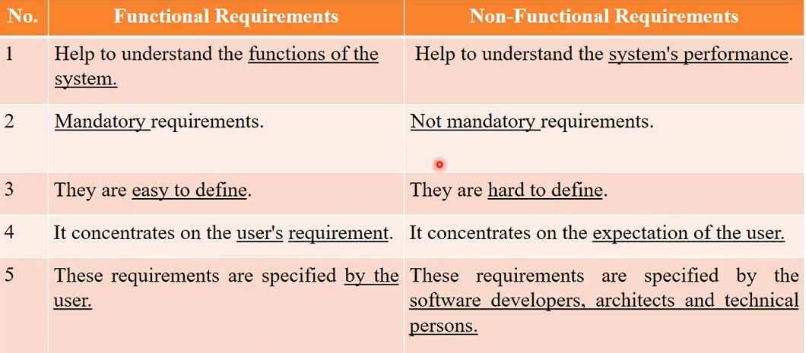

Slide 35
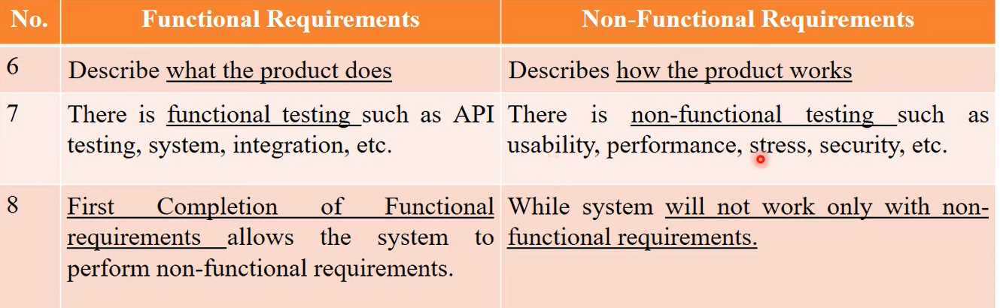

Slide 36
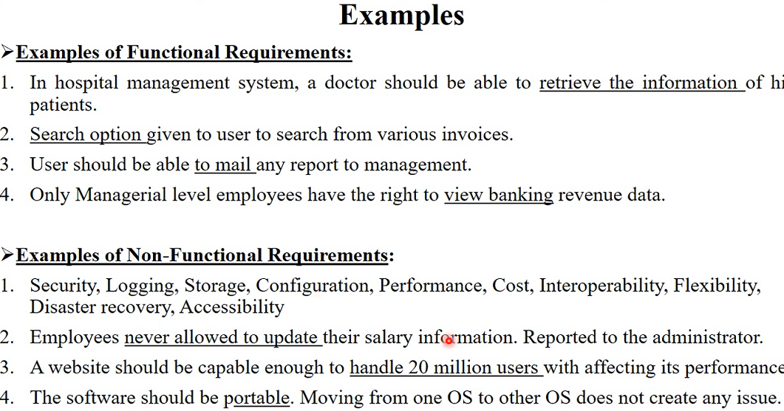

Slide 37
Agile Modeling
A set of criteria that an agile model should meet, these are:
Agile models provide positive value
Agile models fulfil their purpose (and no more)
Agile models are understandable
Agile models are sufficiently accurate
Agile models are sufficiently consistent
Agile models are sufficiently detailed
Agile models are as simple as possible
Agile models provide positive value. That is, is there a real need for the model, will it help in the general aim of producing the final deliverable software? If not, then within the Agile Modelling philosophy it is not required.

Slide 38
Agile Modeling
Agile models fulfil their purpose (and no more). For example, if that purpose is for John to explain to Steve and Dave how their code should integrate with his, then a drawing on a white board may be good enough to serve its purpose (so don’t use a heavyweight tool such as Rational Rose to do this!).
Agile models are understandable to their intended audience but not necessarily to everyone. That is, the level of detail and the content needs to be appropriate for Steve and Dave, but not necessarily to any software engineer from any other project.
Agile models are sufficiently accurate. Recently, I had to explain how the Java- Mail API worked to some colleagues. I was doing so in order that they could have a general understanding of what our software was doing (but they would not be involved in the actual software development, rather they would be administering the email accounts). As it had been awhile since I had last looked at the Java Mail API, I gave then an overview in which I got the general ideas across (using a mixture of UML like diagrams and flow charts). I was even unsure of the exact names of some of the classes but I still got the point across!

Slide 39
Agile Modeling
Agile models are sufficiently consistent. If one model has more detail in than another, so what! As long as they are both understandable by their target audiences it does not matter.
Agile models are sufficiently detailed. For example, when John explains to Steve and Dave about the structure they need to integrate with, many details not relevant to them can be left out – it may be sufficient merely to get the general concepts across.
Agile models are as simple as possible. The less information within a model, the easier it is for the reader to absorb. Within UML, there are a wide range of notational elements that can be applied to most diagrams. However, very few UML diagrams employ as many of these as is possible and in my experience very few of them need as many as they have.

Slide 40
some agile modeling practices

Slide 41
Scenario
The project room walls are exposed (no furniture against them) and covered in whiteboards and static-cling-sheet whiteboard material.
It's Monday, at the start of a three-week iteration. The team of eight developers has decided to spend two or three hours at the walls to understand better and communicate some ideas.
Afterwards, they will start programming. They split into groups. Group 1 explores the object design for the main scenario. On one half of one wall, they sketch UML sequence diagrams. It isn't perfect UML; liberties are taken for sketching.
After 15 minutes, they move to the other half of the wall and sketch a class diagram that complements the sequence diagram.
Over three hours, they move back and forth, developing two complementary diagrams. Finally, they take pictures, print them, and erase the boards. When programming later, the printouts provide some inspiration—some design ideas in code are inspired by the prior thought, and some are not.

Slide 42
Advantages of Agile model
Customer satisfaction by rapid, continuous delivery of useful software.
People and interactions are emphasized rather than process and tools.
Customers, developers and testers constantly interact with each other.
Working software is delivered frequently (weeks rather than months).
Face-to-face conversation is the best form of communication.
Close, daily cooperation between business people and developers.
Continuous attention to technical excellence and good design.
Regular adaptation to changing circumstances.
Even late changes in requirements are welcomed.

Slide 43
Disadvantages of Agile model
In case of some software deliverables, especially the large ones, it is difficult to assess the effort required at the beginning of the software development life cycle.
There is lack of emphasis on necessary designing and documentation.
The project can easily get taken off track if the customer representative is not clear what final outcome that they want.
Only senior programmers are capable of taking the kind of decisions required during the development process. Hence it has no place for newbie programmers, unless combined with experienced resources.

Slide 44
Agile Process models
Extreme Programming(XP)
Adaptive Software development(ASD)
Dynamic software Development Method(DSDM)
Scrum
Crystal
Feature Driven development (FDD)
Agile Modeling(AM)

Slide 45
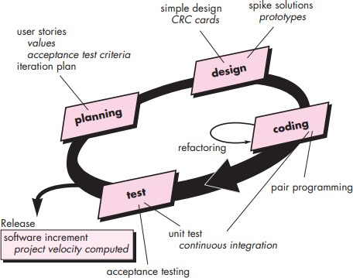
Extreme Programming(XP)

Slide 46
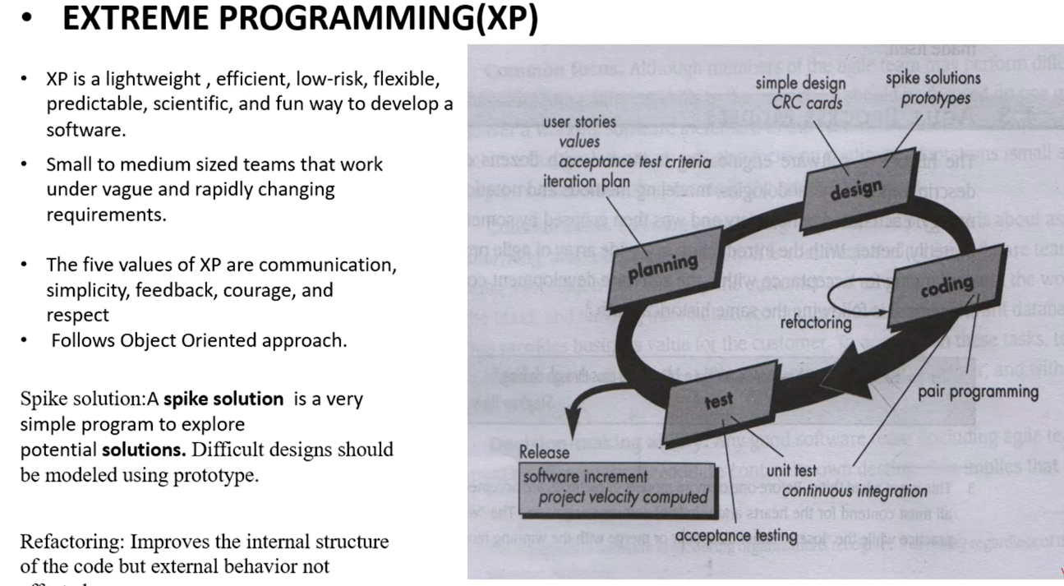

Slide 47
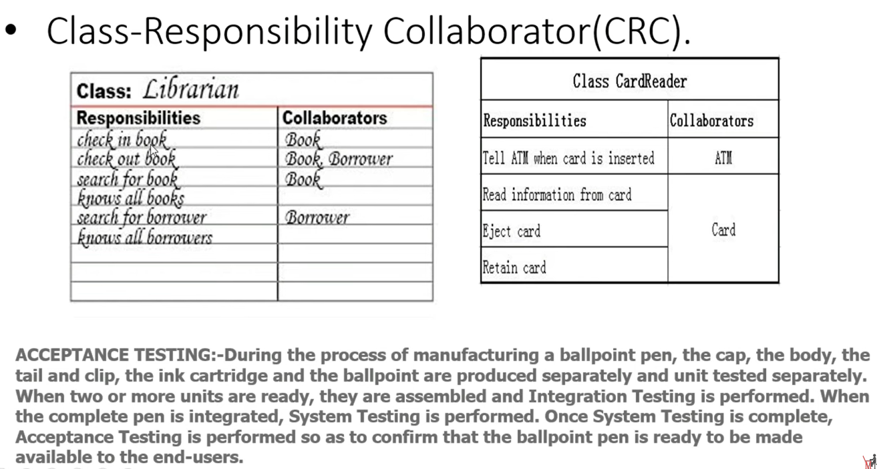

Slide 48
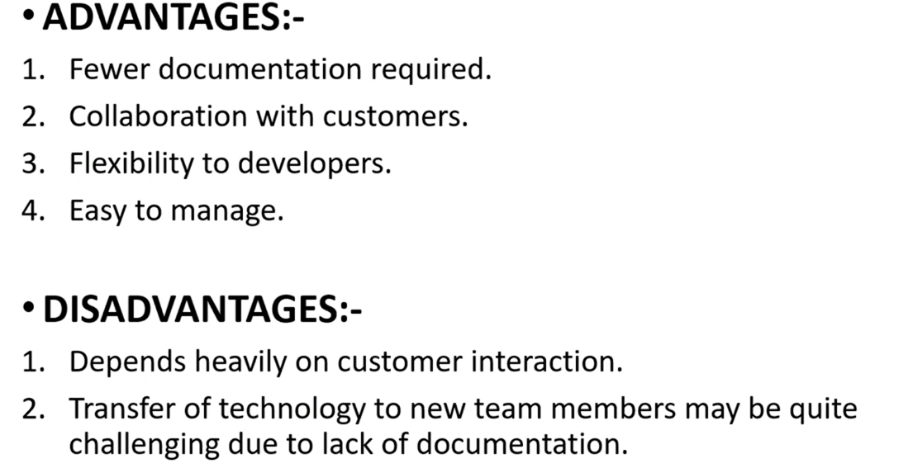

Slide 49
XP’s basic principles
Communication – it is good to talk (particularly, between users and developers).
Simplicity – keep it simple and grow the system as and when required.
Feedback – let users provide feedback early and often.
Courage – to go with such an approach.

Slide 50
---continue
Extreme Programming uses an object-oriented approach as its preferred development paradigm and encompasses a set of rules and practices that occur within the context of four framework activities: planning, design, coding, and testing.

Slide 51
XP: eXtreme Programming
Extreme Programming, or as it is more commonly known XP, was originally designed as a way of supporting small development teams working within uncertain and changing requirements.
It was a response to many of the more traditional heavyweight approaches that are often overkill for small software developments.

Slide 52
XP: eXtreme Programming (Contd.,)
However, it was not an attempt to throw everything away and just program (which is a common misinterpretation of XP).
Rather, XP was designed as an approach based on software engineering principles but focused on the timely delivery of software that meets users’ requirements.

Slide 53
XP: eXtreme Programming (Contd.,)
An important aspect of XP is the empowerment of the actual developers – they should be able to react immediately to changing customer requirements, even late in the development life cycle.
The team, in turn, incorporates management, technical personnel and end users all cooperating towards the common good.
It takes as one of its aims that teams communicate and constantly pay attention to all the details necessary to make sure that the software being developed matches the user requirements, to help to produce quality software.

Slide 54
XP’s IdeasKey
The previous four basic principles have led to the following key ideas presented within XP:
Code in pairs: This is probably the thing that people first hear with relation to XP. The idea is that all software is developed in pairs. The concept is that if code reviews are good, because they force at least one other person to consider your code, then constantly working in pairs results in constant reviewing of code and feedback between the two developers.
Stay in contact with the customer: For example, place a customer representative in the team, so that you have access to them all of the time. Meet regularly with the customer to give information and receive feedback.

Slide 55
XP’s IdeasKey--continue
Create tests before coding then test heavily: Developers should write the unit tests before the code to be tested. Part of the argument is that if you can’t write the test, then you shouldn’t be writing the code. You should then automate testing so that you can regularly re-run the tests to make sure that nothing that has been done breaks earlier results.

Slide 56
XP’s Key Ideas--continue
Short iterations: Each iteration should be relatively short allowing for rapid and frequent feedback. Thus, a minimal system may be produced and possibly even put into production quickly and the system will grow in whatever directions prove most valuable.
Keep it simple: Start projects with a simple design that can evolve later as required by future iterations. This removes unnecessary complexity from early iterations. It also removes the need to code in additional functionalities believed to be required by future iterations, but which may actually never be needed.

Slide 57
XP’s Key Ideas--continue
Don’t anticipate: code for current needs. That is, don’t over-engineer solutions based on what they may one day need to do, rather focus on what they need to do now and leave tomorrow’s functionality to tomorrow.
Collective ownership: Everyone within the team owns the software and has responsibility for it. When something goes wrong, no one should ever consider it not to be his or her problem because Bill wrote that piece of code. In turn, XP does not support a culture of blame and recrimination – everyone is responsible for all the code. As a result of this, everyone is responsible for fixing a problem when they find it rather than ignoring it.

Slide 58
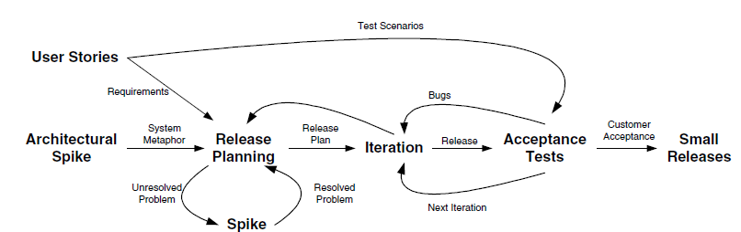
XP Project Lifecycle
XP does provide a software development lifecycle model as well as guidelines on the organization of a software development team.
Fig: XP lifecycle.

Slide 59
User Stories
User stories are similar in some respects to Use Cases from the Rational Unified Process in that they aim to capture how the user will use the system.
However, they are written by the users themselves and not by the development team.
Note that the users should not be limited to describing just the user interface. Rather the user stories should describe how the user would use the system to accomplish something.
It is worth noting that User Stories are not detailed requirements. These will be obtained during the iterations, when and if the aspect of the system covered by a particular user story is to be implemented.

Slide 60
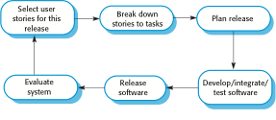
The extreme programming release cycle

Slide 61
Architectural Spike
A Spike in XP terms is an attempt to reduce the risk associated with an unknown area of the system, technology or application domain.
A Spike may involve some investigation, research and possibly some software to evaluate or elucidate the problem.
At this stage research and analysis of the architecture to use should be carried out and fed into the release planning meeting. Other spikes are used during the project-planning phase to determine unresolved issues.

Slide 62
Release Planning
A release-planning meeting is used to create the release plan, which lays out the overall project.
That is, the release plan indicates which user stories will be implemented and in which release this will happen.
It also indicates how many iterations are planned and when each iteration will be delivered.
This is done by negotiation between the interested parties using estimates derived from the user stories.
The estimates are produced by the technical members of the team potentially with input from the users.

Slide 63
Release Planning (Contd.,)
The users priorities the user stories possibly with input from the technical team members.
From this, the timescales for the project, the delivery dates of various iterations, and the final system delivery are all negotiated.
If it is found that management or users are unhappy about the proposed delivery dates, then one or more of the features of the system, the resources available or the time taken must be modified until all participants are happy.
Note that individual iterations are planned just before the iteration commences, not in advance.

Slide 64
Iterations
Each iteration within the project adds to the agility of the development team.
That is, at the start of each iteration changes can be made to what will be done and when it will be done.
The shorter the iteration, the quicker the development team can respond to changes (indeed within XP it is recommended that iterations last only a matter of weeks).
At the beginning of each iteration, an Iteration Planning meeting is held to determine exactly what will happen within that iteration (such as what programming tasks there will be and when they will be done).

Slide 65
Iterations (Contd.,)
Such just-in-time planning is considered an easy way to stay on top of changing user requirements.
If, however, it looks like the iteration will not manage to achieve all that was planned for it, then further iteration planning meetings should be called during the iteration to respond to these concerns.
These meetings might need to re-estimate current and future tasks and determine what can and can’t be achieved. The overriding concern here should be to concentrate your efforts on completing the most important tasks as chosen by your users rather than having several unfinished tasks chosen by the developers.

Slide 66
Acceptance Testing
The acceptance tests are created from the user stories, written at the start of the project.
Each iteration implements one or more user stories; these stories will be translated into a series of acceptance tests during the iteration.
To do this, the customer must specify scenarios to test whether a user story has been correctly implemented.
A story is not limited to one acceptance test and may be related to many acceptance tests (depending on the complexity of the scenario).

Slide 67
Acceptance Testing (Contd.,)
Interestingly, it is the users who assess the results of the acceptance tests and reviewing test scores to decide which failed tests are of highest priority.
Acceptance tests are also used as regression tests prior to a production release. Thus, Acceptance tests should be automated so they can be run often.
Indeed in each iteration, all previous Acceptance tests should be run to ensure that nothing has been broken.
Indeed, contrary to some popular misconceptions, XP has Software QA at its heart and encourages the QA team to be very closely related to the development team.

Slide 68
Release
XP promotes the concept of “small releases” and “release often.”
The release planning meeting should identify meaning “chucks” of system functionality that makes business sense in relation to the users and to the state of the system at various intervals.
These meaningful releases should be made available to users when available. This will allow early and frequent feedback from the users rather than relying on the big bang approach and then worrying about the consequences.

Slide 69
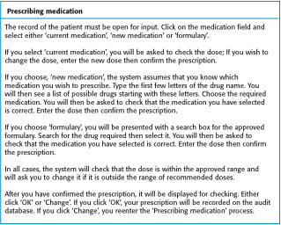
A ‘prescribing medication’ story

Slide 70
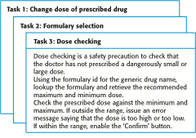
Examples of task cards for prescribing medication

Slide 71
Story card for document downloading

Slide 72
Task cards for document downloading

Slide 73
Test case description

Slide 74
Assignment -1
Why Is XP Controversial?

Slide 75
Why XP is controversial?
XP is/are…
- a hackers paradise or the very least encourages
- Programmers get to work in pairs!!!!!!!!!!
- doesn't force team members to specialize
- doesn’t conduct a up-front analysis and design of the system

Slide 76
Dynamic Systems Development Method
(DSDM)
DSDM or The Dynamic Systems Development Method provides a framework of controls and best practice for Rapid Application Development (RAD).
It is particularly suitable for application development projects that need to develop complex business solutions within tight timeframes.
A worldwide consortium of systems developers initially designed (and indeed are still evolving) DSDM (now in Version 4.1).
Their goal was to produce what at the time they referred to as a RAD methodology which has evolved into an Agile Method model that is time, quality and cost sensitive, producing deliverables quickly and accurately – rapid and right.
Since its inception in 1995, more than 20,000 practitioners have been trained and thousands of developers have used DSDM successfully.

Slide 77
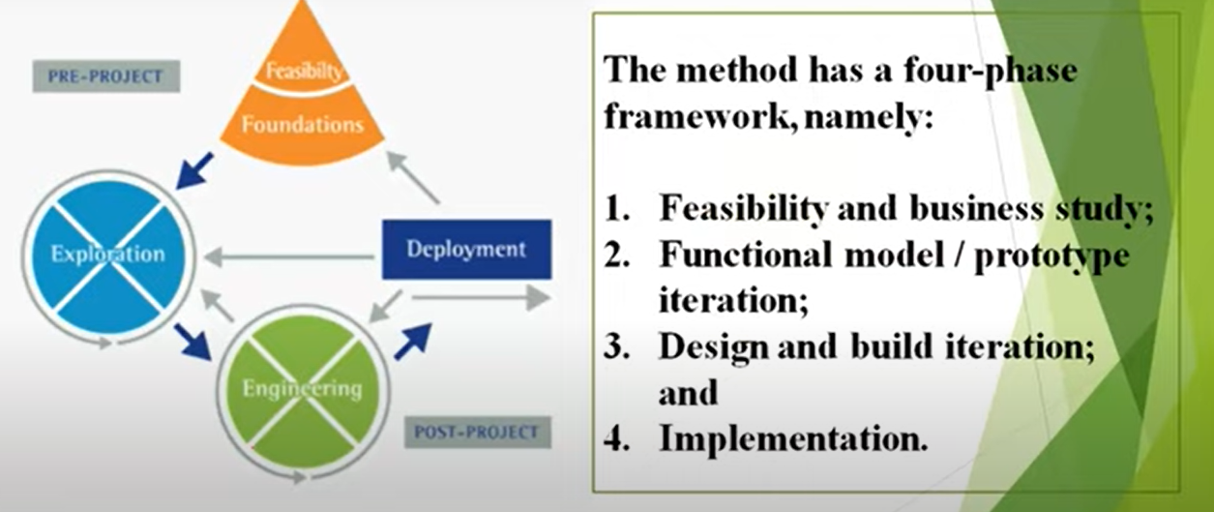

Slide 78
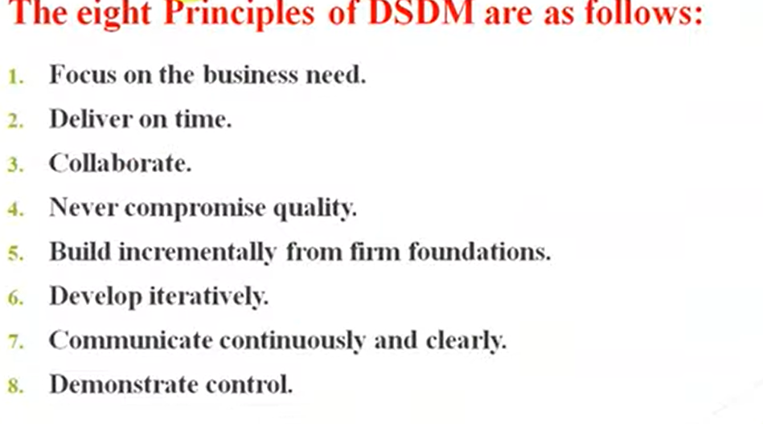

Slide 79
DSDM is based on nine overriding principles
Active user involvement is imperative.
The team must be empowered to make decisions.
The focus is on frequent delivery of products.
Fitness for business purpose is the essential criterion for acceptance of deliverables.
Iterative and incremental development is necessary to converge on an accurate business solution.
All changes during development are reversible.
Requirements are base lined at a high level.
Testing is integrated throughout the life cycle.
Collaboration and cooperation between all stakeholders is essential.

Slide 80
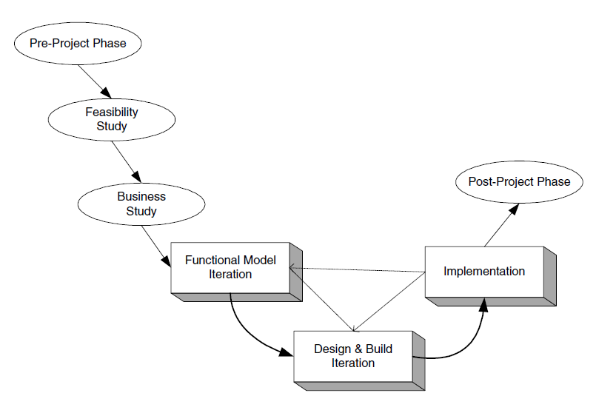
DSDM lifecycle:
Pre-Project Phase
Feasibility Study
Business Case Study
The Functional Model Iteration (FMI)
The Design and Build Iteration (DBI)
The Implementation Phase
The Post-Project Phase
Figure: DSDM lifecycle

Slide 81
DSDM lifecycle (Contd.,)
The first three phases are done sequentially in order.
These phases set the ground rules for the rest of development process allowing users and teams to understand the world within which the application must execute as well as what will be expected of the end product.
The Feasibility Study phase
The Feasibility Study phase is expected only to last a few weeks.
The output of this phase is a “feasibility report” that assesses whether or not to use DSDM for the particular project. It should also consider issues surrounding the people and organisations involved, and define the general scope of the project and its objectives.
This phase should also produce an outline plan for the development of the end product.

Slide 82
The Business Study phase
The Business Study phase of the project should have three outputs; these should be the Business Area Definition (BAD), the System Architecture Definition (SAD) and the Outline Prototyping plan.
Business Area Definition. Identifies the high-level requirements and provides a process description of the end product.
System Architecture Definition. Sketches out the architecture of end system.
Note that it is likely that this will evolve over the life of the project.
Outline Prototyping Plan. This states the prototyping strategy to be adopted for the development of the end product.

Slide 83
The FMI (Functional Model Iteration)Phase
The core phases of the DSDM are the FMI, the DBI (Design & Build Iteration) and the Implementation Phase.
The FMI Phase involves:
Analysis of the features to be designed and implemented.
The production of the Functional Model. This is the primary output of this phase. It may include prototype code as well as analysis models.
Coding and prototyping. Prototypes may be used to help improve the analysis or understanding of the system. These prototypes may continue to evolve (particularly in the next phase) until the quality level achieved is high enough that they can be used in the delivered system.

Slide 84
The DBI Phase
Designing and Building the features to be implemented during this phase. This involves reviewing the designs produced so far, the functional prototypes, as well as the creation of code to implement the required functionality.
The primary output of this state is the tested system. This system must meet all the requirements selected as essential in the particular iteration being implemented.

Slide 85
The Implementation Phase
The transfer of the completed system from the development environment to the production environment.
The provision of other deliverables such as User training, the creation of the User Manual and the Project Review Report. If issues arise, then the project can be reiterated back to the appropriate phase.
Post-Project Phase
After the project has delivered the end product, the project team can be disbanded and the Post-Project activities initiated. This phase may cover such diverse activities as providing a help desk for users to ensure that the product operates effectively and checking that the expected business benefits have been achieved.

Slide 86
Within the two main product creation phases (the FMI and DBI) the primary mechanism used for handling the uncertainty considered inherent in the development process is the timebox.
In any project, there is a fixed completion date, which provides an overall timebox for the work to be carried out.
DSDM refines the concept of timeboxing by nesting shorter timeboxes of 2–6 weeks within the overall time frame. Each timebox will typically pass through three phases.
Investigation – a quick pass to see whether the team is taking the right direction.
Refinement – to build on the comments resulting from the review at the end of investigation.
Consolidation – the final part of the timebox to tie up any loose ends.

Slide 87
SCRUM
SCRUM(Schwaber and Beedle, 2001) aims to manage and control the production of software using iterative, incremental and lightweight processes (that is less intrusive processes).
It does this by wrapping up existing methods (such as RUP) and agile methods (such as XP) together to provide a workable agile development methodology.
One of the interesting aspects of SCRUM is that actually it aims to help with the production of a “product” of which software is just one example.

Slide 88
SCRUM
The benefits put forward by the proponents of SCRUM are:
The management and control of development work in an agile manner.
It explicitly acknowledges that requirements may be changing rapidly within its iterative and incremental approach to product development.
It is possible to still use existing engineering practices within SCRUM.
It is an inherently team-based approach and helps to improve communications and co-operation.
It scales from small projects up to very large projects.
It helps to identify and then remove any obstacle to the smooth development of the end product.

Slide 89
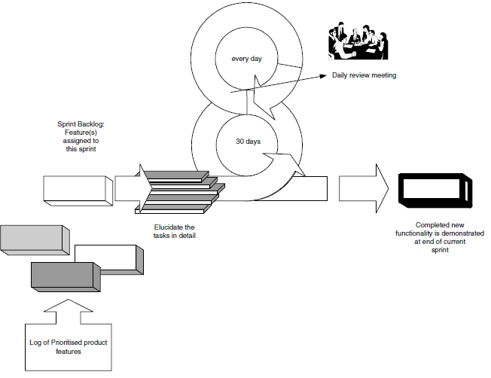
SCRUM (Contd.,)
Core SCRUM is a set of rules, procedures, and practices that are all interrelated and that work together to improve the development environment, reduce organisational overheads and ensure that iterative deliverables match the end users requirements.

Slide 90
--continued
In Agile product development, a sprint is a set period of time during which specific work has to be completed and made ready for review.
SCRUM is based on current process control theories and specifically aims to produce the best end result, given the current resources and time available.
Note that it does not aim to produce the best possible piece of software given unlimited resources – rather it is based within the realities of the modern world and will help to produce the best that can be done given the situation within which it is applied.

Slide 91
SCRUM (Contd.,)
Note that, as well as having an iterative cycle of only 30 days between iterative deliveries, it also employees daily reviews.
These reviews should be short (of, for example,15-minduration), and should force team members to address the basics of the process, namely they should consider:
What has been done by team members since the last meeting.
Is there anything causing a problem? Are there any obstacles to completing their tasks?
What will each team member do before the next meeting?

Slide 92
SCRUM (Contd.,)
Over 50 organisations have successfully used SCRUM in thousands of projects to manage and control work, apparently with significant productivity improvements.
These projects have ranged from financial products, through medical applications to internet solutions.
An interesting observation relating to SCRUM is that it can be viewed as a process that helps to wrap up existing (potentially software) engineering practices within a controlled iterative process.
It provides values, procedures and rules that can help introduce a more dynamic and responsive development process.
SCRUM can be applied from the start of a project or can be introduced during a product’s lifecycle, particularly if a project is facing difficulties in completing all tasks and some form of prioritisation of tasks is required.

Slide 93
Feature Driven Development (FDD)
A feature is a schedulable requirement associated with the activity used to realise it.
FDD is a model-driven, short-iteration process with five basic activities.
For reporting and tracking the project, milestones marking the progress made on each feature are defined.
During the first two sequential activities, an overall model shape is established. The final three activities are iterated for each feature (hence the term, Feature Driven Development).

Slide 94
Feature Driven Development(Contd.,)
Feature-centric management of agile projects offers this element of control. In FDD, Coad (1999) and Palmer and Felsing (2002) present a five-step process that outlines how a feature-centric approach works, these five processes are:
Process 1: Develop an overall model of the domain and create an initial feature list.
Process 2: Build a detailed, prioritised feature list.
Process 3: Plan by feature.
Process 4: Design by feature.
Process 5: Build by feature.

Slide 95
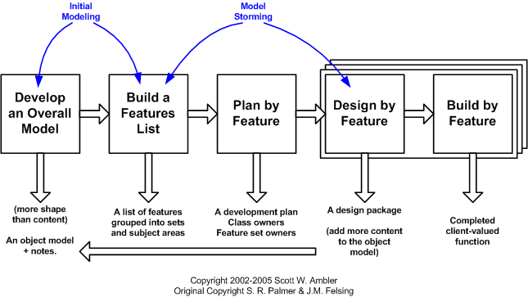
Five Basic Activities in Process Model

Slide 96
Develop Overall Model
Project starts with a high-level walkthrough of the system scope and its context. Next, detailed domain walkthroughs are held for each modeling area.
For each domain (note the ‘loop’), walkthrough models are then composed by small groups, and are presented for peer review and discussion.
One of the proposed models, or a merge of them, is selected which becomes model for that domain area.
Domain area models are then merged into an overall model, and the overall model shape is adjusted along the way.

Slide 97
Build Feature List
Knowledge gathered during initial modeling is used to identify a list of features.
This is done by functionally decomposing the domain into subject areas.
Subject areas each contain business activities and categorized features.
Features in this respect are small pieces of client-valued functions expressed in the form "<action> <result> <object>", for example: 'Calculate the total of a sale' or 'Validate the password of a user'.
Features are short and should not require >= two weeks to complete; otherwise, break them into smaller pieces.

Slide 98
Plan by Feature
After the feature list had been completed, the next step is to produce the Development Plan.
Class ownership is done by ordering and assigning features (or feature sets) as classes to chief programmers.

Slide 99
Design by Feature
Design package is produced for each feature.
Chief programmer selects small group of features to be developed within two weeks.
Together with the corresponding class owners, chief programmer works out detailed sequence diagrams (behavioral modeling) for each feature and refines the overall model.
Next, the class and method prologues are written and finally a design inspection is held.

Slide 100
Build by Feature
After a successful design inspection a per feature activity designed to produce a completed client-valued function (feature) is produced.
The class owners develop the actual code for their classes.
After a unit test and a successful code inspection, the completed feature is promoted to the main build.

Slide 101
Test-driven development (TDD)
Test Driven Development (TDD) is a software development methodology that emphasizes writing tests before writing the actual code. It ensures that code is always tested and functional, reducing bugs and improving code quality. In TDD, developers write small, focused tests that define the desired functionality, then write the minimum code necessary to pass these tests, and finally, refactor the code to improve structure and performance.

Slide 102
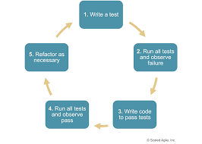
Test-driven development (TDD)

Slide 103
Test-driven development (TDD)
Test-driven development (TDD), also called test-driven design, is a method of implementing software programming that interlaces unit testing, programming and refactoring on source code.
Test-driven development was introduced as part of a larger software design paradigm known as Extreme Programming (XP), which is part of the Agile software development methodology.

Slide 104
Steps of the test-driven development approach
Before any new code is written, the programmer must first create a failing unit test. Then, the programmer creates just enough code to satisfy that requirement. Once the test is passing, the programmer may refactor the design, making improvements without changing the behavior.
While TDD focuses on the programmer interactions at the unit level, there are other popular methods, such as Acceptance-Test-Driven Development (ATDD) or Behavior-Driven Development (BDD), which focus on tests that can be understood by customers.
These methods involve creating concrete examples as tests in collaboration between the technical staff and customer before the code is created, and then running the tests after the code is created to demonstrate the code is implemented. Having the tests known upfront improves first-time quality.

Slide 105
--CONTINUE
ATDD and BDD require developers, testers and the business side to collaborate to imagine and discuss the software and its implications before the code is created.
Behavior-driven development (BDD) is an Agile software development methodology in which an application is documented and designed around the behavior a user expects to experience when interacting with it.
TDD or Test-Driven Development is a process for when you write and run your tests. Following it makes it possible to have a very high test-coverage. Test-coverage refers to the percentage of your code that is tested automatically.

Slide 106
Advantages of TDD
Test-Driven Development can produce applications of high quality in less time than is possible with older methods. Proper implementation of TDD requires the developers and testers to accurately anticipate how the application and its features will be used in the real world.
TDD creates a regression-test suite as a side effect that can minimize human manual testing, while finding problems earlier, leading to quicker fixes. The methodical nature of TDD ensures much higher coverage and first-time quality. Because tests are conducted from the very beginning of the design cycle, time and money spent in debugging at later stages is minimized.

Slide 107
Disadvantages of TDD
TDD requires considerable skill to be successful, especially at the unit level. Many legacy systems are simply not created with unit testing in mind, making isolation of components in order to test impossible.
Further, many programmers lack the skills to isolate and create clean code. Everyone on the team needs to create and maintain the unit tests, or else they will quickly get out of date. And an organization looking at TDD will need to invest time -- to slow down a bit now in order to go faster later.
Finally, as with any method, the final results of TDD are only as good as the tests that have been used, the thoroughness with which they have been done and the extent to which they mimic conditions encountered by users of the final product.

Slide 108
Modelling Misconceptions
Before discussing Agile Modelling, it is worth reconsidering some modelling myths and misconceptions that need to be clarified. These have a bearing on Agile Modelling as a modelling misconception can lead to a denial of the benefits that can be accrued from Agile Modelling.
Models equal documentation.
Modelling implies a heavyweight software process.
You must “freeze” the requirements.
Your design is carved in stone.
You must use a CASE tool.
All developers know how to model.
You can think of everything from the start.
Modelling is a waste of time.
The world revolves around the data model.

Slide 109
Modelling Misconceptions (Contd.,)
Models equal documentation:
Nothing could be further from the truth! A model is part of the documentation, but it is by no means sufficient as documentation. That is, a (UML) model, as good as it may be, cannot adequately represent all the information needed to describe how the requirements (functional and nonfunctional), behavioral and structural of a software system are to be implemented.

Slide 110
Modelling Misconceptions(Contd.,)
Modelling implies a heavyweight software process:
Again this is not true. The fact that you are using some form of modelling to describe your system does not mean that you must be using a formal software development process. It may well be that placing the modelling task within the context of a development methodology may well help, but modelling does not equate to a software process.

Slide 111
Modelling Misconceptions(Contd.,)
You must “freeze” the requirements:
The point here is that many people believe that you must be able to freeze the requirements before you start to model. In theory this would be great. If you had all the requirements presented to you before you start modelling, then all the questions about what the system should do would be answered at the start. It would also make deciding on what should be in the model easier. However, that is theoretical, in reality requirements change (even in the smallest projects). This can be for a variety of reasons.

Slide 112
Modelling Misconceptions(Contd.,)
Your design is carved in stone:
This is a leftover from the more traditional waterfall-based approaches to software development. In an ideal world, you would like to remove as many unknowns and variable elements from software development as possible. Therefore, to have the design “fixed” and never changing would be great. Again this does not work in reality.
This is for a variety of reasons, including changing requirements, but also the fact that designs are an abstraction of the implementation. This means that as an implementation is progressing some elements of the design may be found to be unimplementable, inefficient or fatally flawed.

Slide 113
Modelling Misconceptions(Contd.,)
Thus, during the implementation some changes may be required to the design to ensure a working system, etc. In addition, there may be some situations in which it is difficult to define more than a highly abstract model, as not enough is known at that point about how the system should work. Thus, the model will need refinement at a later date when some missing information or understanding becomes available.
I know some of you may be thinking that you should not move on from the modelling phase until you have this information, but in the real world there are times when you don’t have a choice.
You must use a CASE tool:
By this I mean that if you are going to do some modelling you must use some form of Computer Aided Software Engineering tool such as Together Soft's Together Control Centre or Rational’s Rose. Of course, these tools may well make things easier, but they are not mandatory.

Slide 114
Modelling Misconceptions(Contd.,)
All developers know how to model:
Generating appropriate, correct, well-formed, understandable models is not trivial. It takes time to get familiar with whatever tools, notation and approaches are being used. Just as with programming itself, the more modelling you do, the better you get. In addition, the more you study the models generated by yourself or your colleagues, the more you will learn. Thus, just taking a developer and asking him/her to start creating a sound robust model of sufficient clarity and abstraction is generally a flawed approach.
You can think of everything from the start:
One problem with UML style models is that they are static – that is, you cannot execute them. So, it is hard to determine whether they cover “enough” or whether you have missed out some critical areas. Therefore, believing that you can think of everything and cover all eventualities at the start of modelling is wrong for all but the simplest systems.

Slide 115
Modelling is a waste of time.
I have both heard, and had to deal with, this myth. This myth represents the extreme opposite of that promoted by the waterfall boys– that is, Designing models has no benefit, just get on with the coding – that’s what you are delivering after all. The model is not what gets delivered to the user and is not what will meet their eventual needs.
“which would you prefer to live in, a tower block in which the architect first draws up plans, scale models and prototypes to confirm any outstanding issues or one where the builders just got on and did it?” Personally I would be happier in the one where some models were generated. And to some extent software is the same. On a personal level, I have found that working on software that can be placed within the framework of a model and in which the model provides the starting point, the basic structure and the context is extremely useful and I believe this helps to produce more robust systems.

Slide 116
The world revolves around the data model.
That is, the data model describing, for example, the information in the database, is the centre of the universe and the object-oriented model is based on this.
This is a view that is prevalent in organisations with a very strong database culture or in those that have migrated from a more data-oriented language.
However, while there is certainly a mapping between the object and relational worlds it is not the case that the data model dictates the object model.
The two maybe very closely aligned or they maybe quite distinct – it depends on the application, etc.
The data model used with the database is very important. However, the database was only one part of these systems and the other parts were just as important.

Slide 117
Assignment-2
What is Agile Modelling and Explain in detail?

Slide 118
Tool Misconceptions
While considering some misconceptions and myths relating to the use of tools, modelling and UML.
UML requires CASE tools.
Modelling requires the use of CASE tools.
Agile modellers don’t use CASE tools.
UML is all you need!
The CASE tool is master.

Slide 119
1. UML requires CASE tools
This is certainly not true – I can draw a UML diagram freehand on paper, use a simple drawing package such as Paint or indeed with a tool such as Together. It may well be true that to strictly adhere to the UML notation it is easier to use something that knows about UML. It may also be true that if you want to generate code from the UML diagrams, using a CASE tool such as Rose or Together makes life easier. But it is not a pre-requisite.

Slide 120
2. Modelling requires the use of CASE tools
An extension of the last point is that if you are going to create models as part of your design you need a CASE tool that can manage, manipulate, cross reference, etc., your models. While these features may well be useful, they are not necessary.
It can (and indeed have) used simpler tools such as Visio to perform all the modelling necessary for the design of a system. Obviously, the larger the system and the larger the amount of modelling performed, the better a CASE tool may be.

Slide 121
3. Agile modellers don’t use CASE tools.
This is a common misconception by those starting with Agile Modelling.
This is partly due to the emphasis of Agile Modelling on using the simplest appropriate tool and if that tool is a white board or a piece of paper, use it. The key word here is appropriate.
If I need to work something through with one of my colleagues, we might well use a white board or a piece of paper and not worry too much about the accuracy of the UML notation being used.
If however, I am trying to describe a complex structure that will need to be referenced by a variety of developers, possibly in multiple locations, then a CASE tool might well be the most appropriate.

Slide 122
4. UML is all you need!
Some take the view that UML is all you need in terms of notation – if you can’t do it in UML (aka the design tool you are using), then it is either not relevant to an object-oriented system or not important enough to document.
This is not true. There are many aspects of a software project that you may wish to document, but do not fit within the remit of a UML diagram, for example, GUI storyboarding, data modelling, etc.

Slide 123
5. The CASE tool is master
This is more a perception than a misconception. It is a perception because users often feel that they are battling with the CASE tool and that they have to work in the way prescribed by the CASE tool.
Certainly, I know that some of the colleagues I have worked with over the years have an almost irrational hatred against one well known CASE tool because of the way it forces them to work. Some of this can be overcome with training and some by choosing a suitable tool.
The important thing is that the CASE tool should not be the master but the servant. It should help you with your work and not hinder it. Thus, finding an appropriate tool (or tools) is important.
For example, in one case Together proved to be particularly well suited to the organisations way of working and to the developers experience and background.

Slide 124
Updating Agile Models
Update Only When It Hurts:
You should update a model only when you absolutely need to, when not having the model updated is more painful than the effort of updating it.
With this approach you discover that you update a smaller number of models than you would have in the past because the reality is that your models don't have to be perfect to provide value.

Slide 125
--CONTINUED
The street map that I have to my town is over five years old, I know this because my own street doesn't appear on it and it's been in place for a little over five years, yet the map is still useful to me. Yes, I could purchase an updated map, one comes out every year, but why bother? Missing a few streets isn't painful enough to warrant this investment, it simply doesn't make sense to spend the money to purchase a new map every year when the one that I have is good enough. Too much time and money is wasted trying to keep models and documents in sync with source code, an impossible task to begin with, time and money that could be better spent developing new software. This practice is particularly important for agile documentation.

Slide 126
THANK YOU

